Slide 1

Parametric Model Design for 3D Printing
David S Tyree dtyree77@gmail.com
Maker Group

Slide 2
Examples & Presentation
The examples and this presentation can be found here:
http://github.com/celer/3d-things
You can download a zip file from here or install git
Install git http://git-scm.com/downloads
Then clone the repo
git clone git://github.com/celer/3d-things.git
Quick intro to git
http://git-scm.com/videos
http://git-scm.com/book/en/Getting-Started

Slide 3
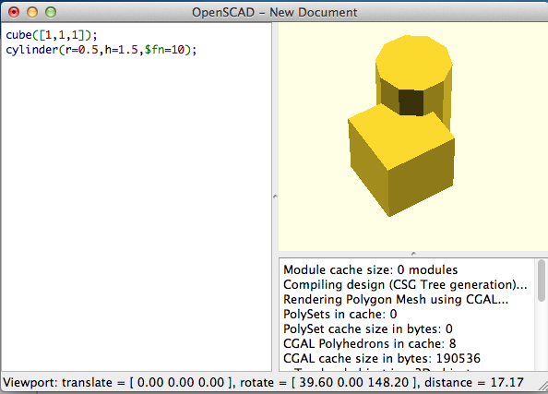
An introduction to OpenSCAD
Type here
See it here

Slide 4
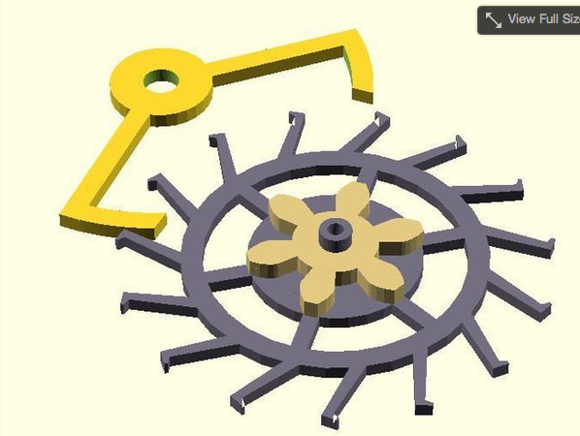
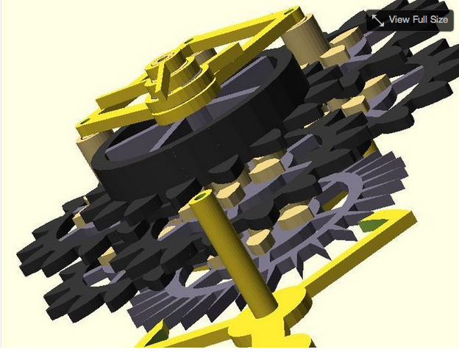
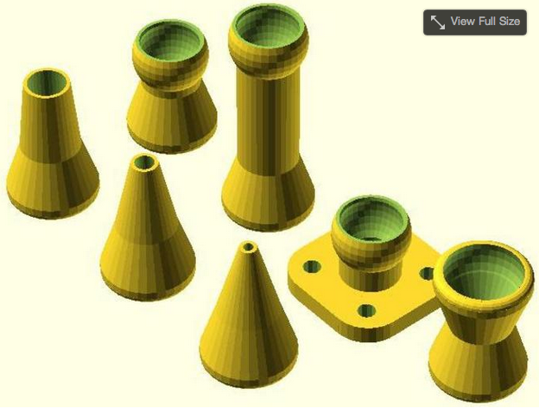
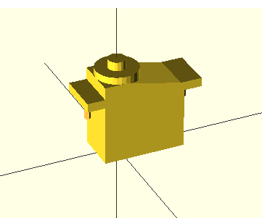
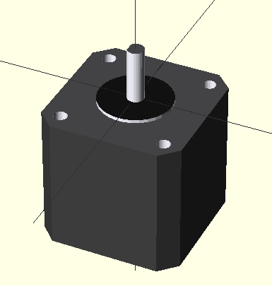
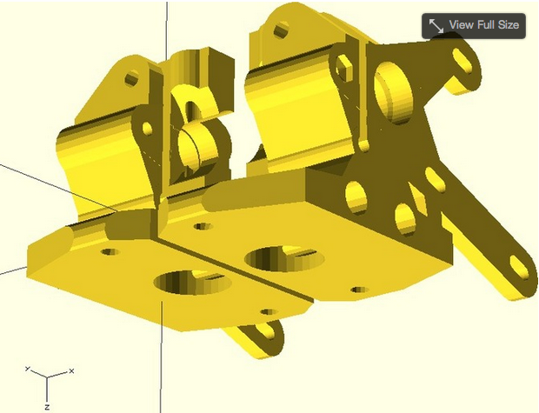
OpenSCAD is amazing! (These are random things from thingiverse)

Slide 5
Diving in!
www.openscad.org
It’s free!
It works on every major platform
Produces dimensionally accurate designs (by default all units are MM)
To use it for 3D Printing
Type in your design
Render it
Save it to a .STL file
Use a Slicer to convert the .STL file to a .GCODE File
Print!

Slide 6
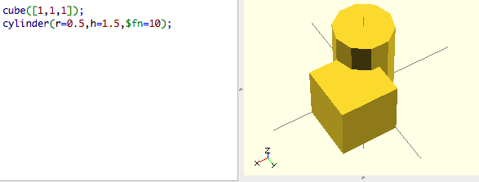
Shapes
You type in the shape’s you want
cube[x-dimension,y-dimension,z-dimension]);
cylinder(r=radius,h=height)
sphere(r=radius)
You can modify the shapes by adding:
center=true - center the shape
$fn=fineness – adjust the fineness of the generated shape
etc

Slide 7
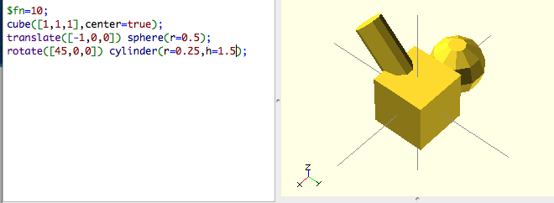
Modifying Shapes
You can modify a shape using these commands
translate([moveByX,moveByY,moveByZ])
scale(newScale) or scale([scaleX,scaleY,scaleZ])
rotate([rotateX,rotateY,rotateZ])
Modify a shape by placing the command before it or by putting the shapes in braces ‘{}’

Slide 8
How to select what to modify
Modify a single shape
rotate([45,0,0]) translate([1,0,0]) cube([1,1,1]);
You can chain modifications
The order matters! (move then rotate != rotate then move)
First translate (move)
Then rotate
Modify a collection of stuff
rotate([45,0,0]) translate([1,0,0]) {
cube(1,1,1);
scale(1.5) sphere(r=2);
}
Operations are applied in reverse order
sphere(r=2) is first scaled, then translated and finally rotated

Slide 9
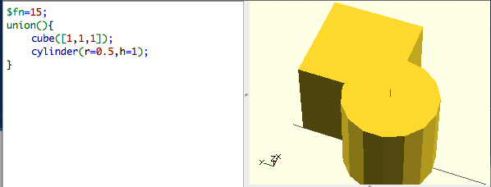
Union
union(){ }
Produce a shape by combining all the shapes

Slide 10
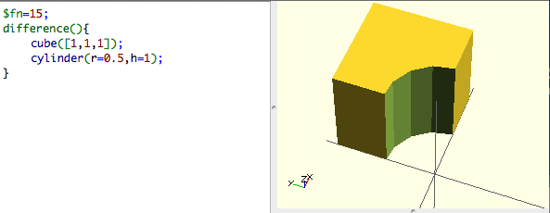
Difference
You can perform operations on shapes to create new shapes
difference(){ shapeA(); shapeB(); shapeC(); }
Subtract shapes from each other
shapeA-(shapeB+shapeC)

Slide 11
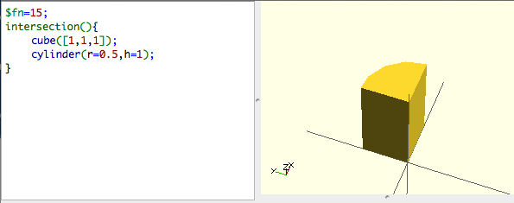
Intersection
intersection(){ }
Product a new shape from the intersection of shapes

Slide 12
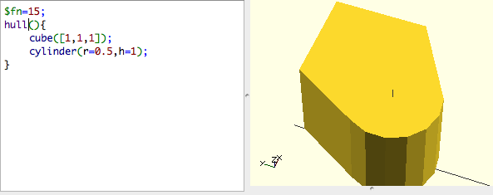
Hull
hull(){ }
Produce a shape by combining the profiles of two shapes

Slide 13
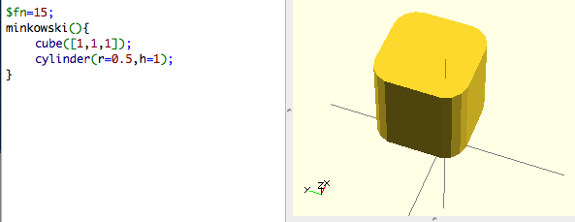
Minkowski
minkowski(){ }
Produce a shape by tracing one shape around another
This will trace the cylinder around the cube

Slide 14
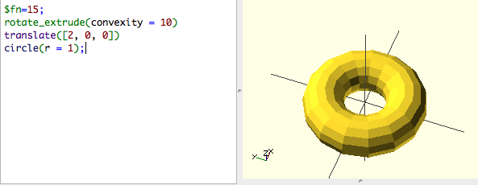
Rotate & Extrude
rotate_extrude(){ }
Produce a shape rotate it and extruding it

Slide 15
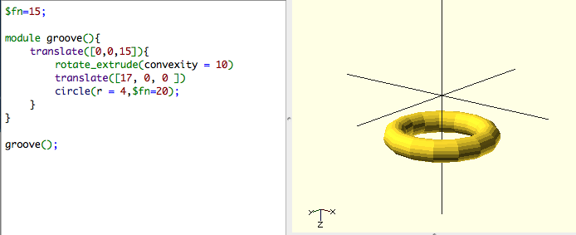
Modules
Modules let you combine a bunch of shapes and operations into a single thing so you can re-use.
They also let OpenSCAD cache a shape

Slide 16
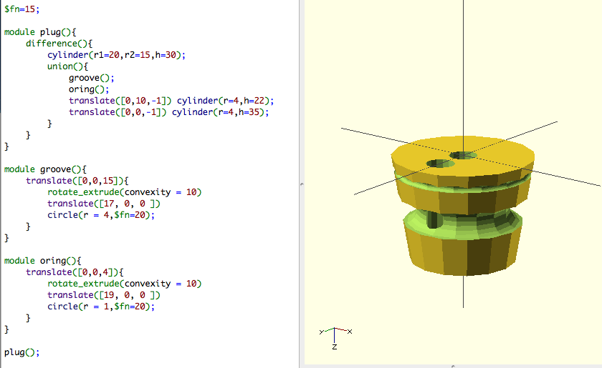
Composite shapes!

Slide 17
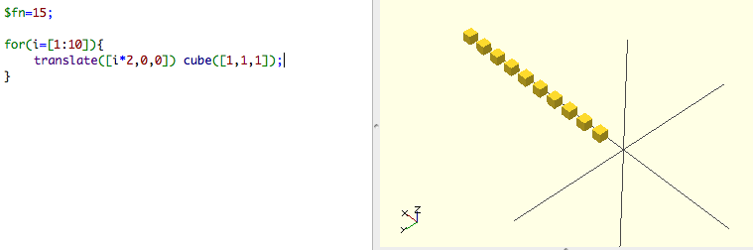
Loop & Iterate
OpenSCAD has variables
i=5; //set I to 5
You can loop or iterate with openscad
for(variable=[start:increment:end){
}

Slide 18
3D IO The power is in combinations
Inputs
3D Model (.OBJ, .STL)
Thingiverse, Sculptris, Wings3D, 123D Catch, etc
2D Models / Drawings (.DXF, .SVG, PD)
Inkscape, Autocad, QCAD, Desktop Scanner, etc
OpenSCAD can import and use these files
import(“kitten.obj”);
You can then use them like any other shape!

Slide 19
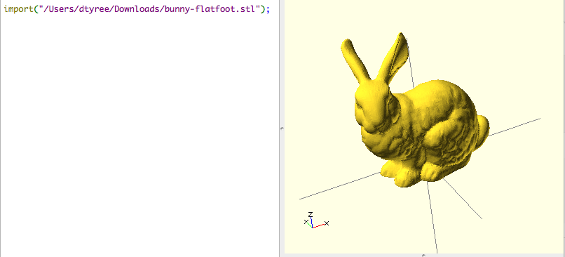
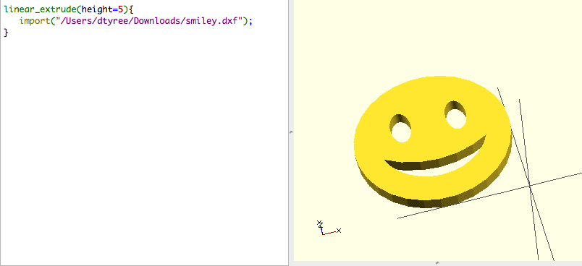
Importing things!

Slide 20
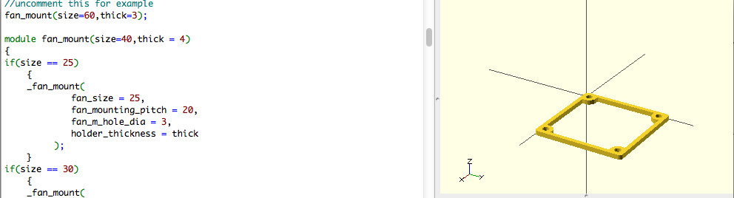
Using libraries
OpenSCAD has a large number of libraries
MCAD ( https://github.com/elmom/MCAD )
Screws, gears, servos, steppers, motors, bolts, etc
Thingiverse
Download the library and then import it
Usually the library will have instructions inside of how to use it

Slide 21
Designing stuff!
What requirements?
What tools / inputs do I have ?
Capture from real life
Desktop Scanner / 123D Catch
Model it
Sculptris, Thingiverse, Sketchup
Can I print it?
Does it have big overhangs?
How dense does it need to be?
How accurately must it be printed to work (0.3mm is what I consider the minimum feature size to be useful)

Slide 22
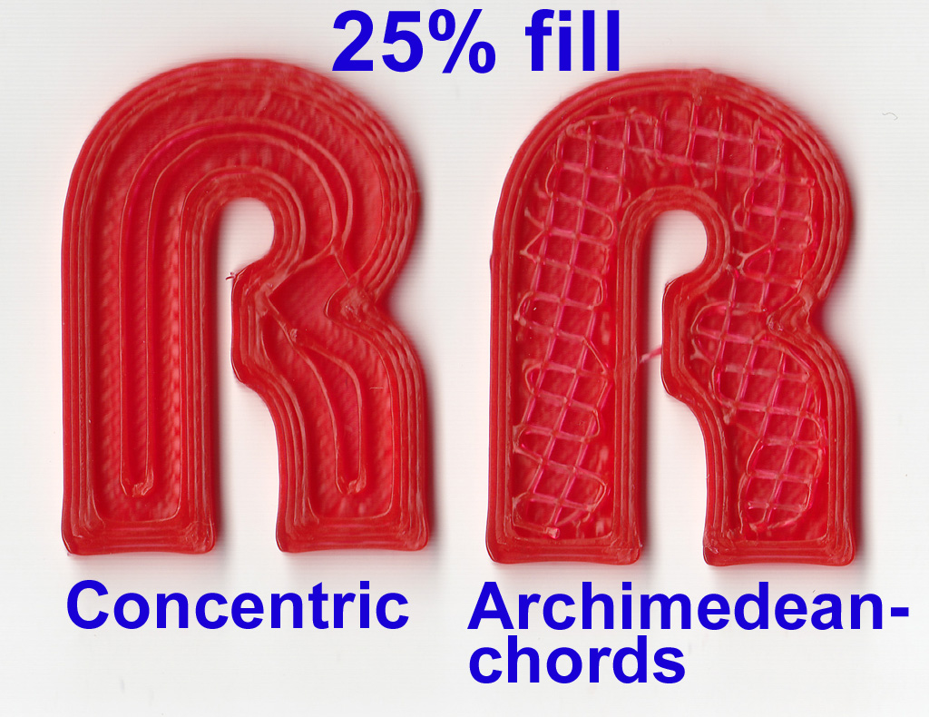
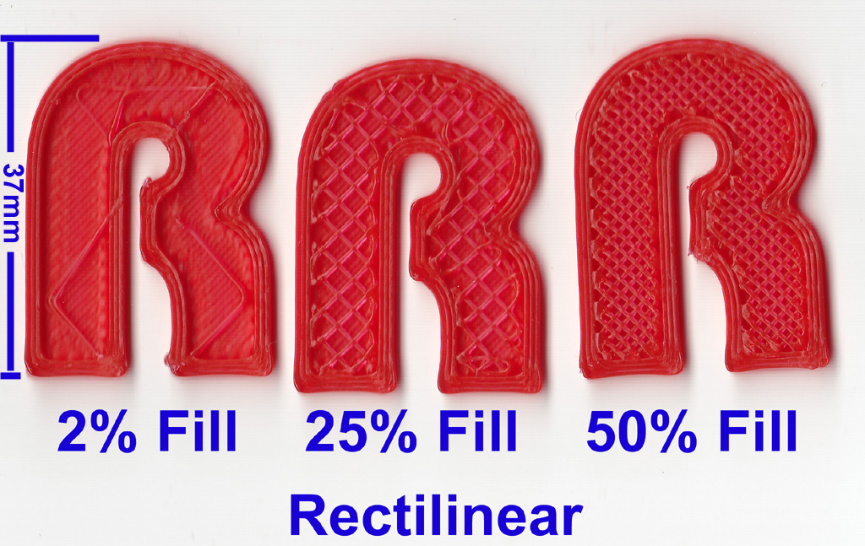
Slicing
After creating the thing we choose some print settings

Slide 23
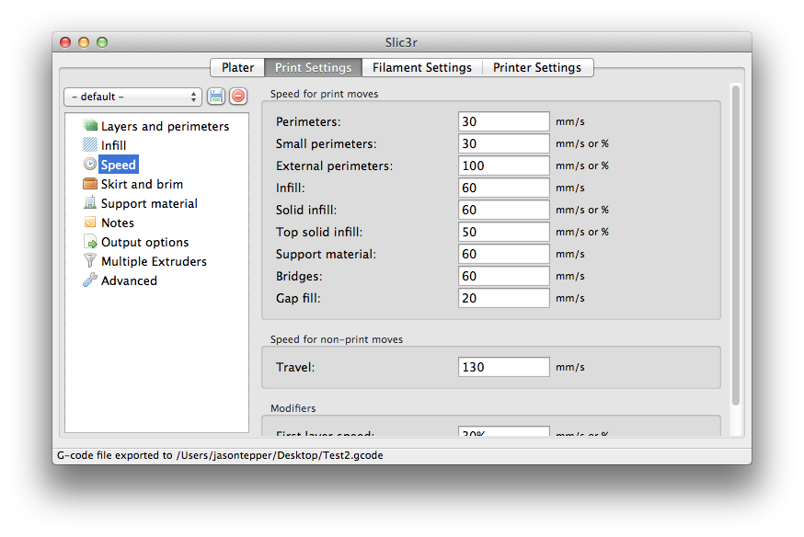
Slicing
After designing the model it is time to print it! (I use Slic3r)
Choose a density and fill pattern
Choose number of top / bottom layers
Choose number of perimeter
Print the generated .GCODE file (I use Printrun)

Slide 24
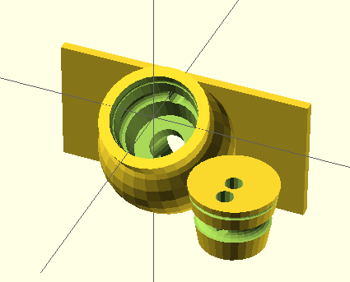
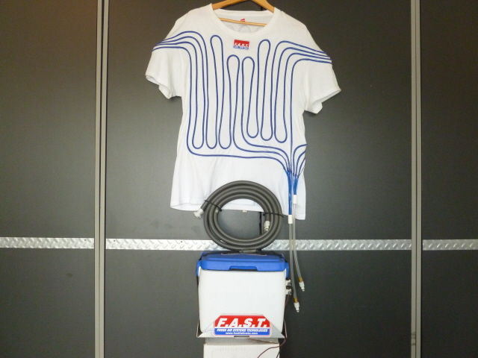
Example: Quick disconnect for cool suit for racing (Drawing it out on paper is a must for this one)
A hose connector for quickly disconnecting hoses for a cool suit, which can be mounted on the side of a cooler
Must disconnect quickly and easily
Must plug back in easily
Must not let it pump water out of the cooler
Must be printable

Slide 25
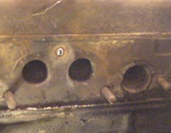
Example: A custom JIG for drilling out a snapped bolt on a motor
You want to build a JIG to drill out a snapped exhaust bolt.
Use a desktop scanner to scan a new gasket for the exhaust
Convert the scanned image to a .SVG/.DXF file
Extrude it with OpenSCAD

Slide 26
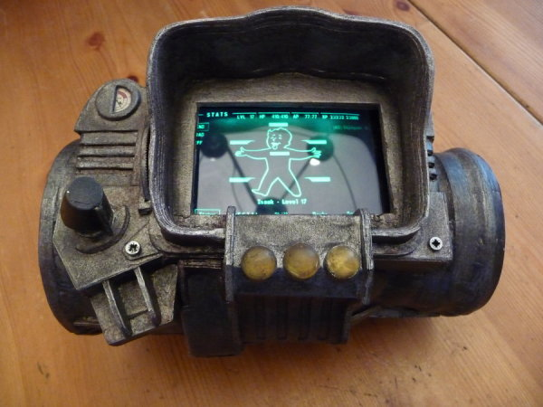
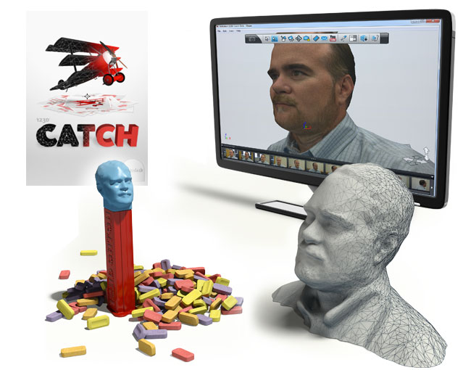
Example: A Fallout PitBoy
You want to build a Fallout Pitboy
You can use 123D catch to acquire a model of your wrist
You can then use a 3D model of the PitBoy and subtract the model of your wrist from it.

